Slide 1
Welcome to System Programming and Security
Dr. Carlos Moreno Garcia
c.moreno-garcia@rgu.ac.uk
@CarlosFMorenoG

Slide 2
Introduction to the Module

Slide 3
Aims of the module
To review the design, implementation and functioning of operating systems.
To provide the student with the ability to proficiently manage the resources provided by operating systems.
To enable the student to deploy secure infrastructure using common operating systems.

Slide 4
Module Organisation
Activity | Details | Contact Hours
Lecture | Main principles and theory | 1 hour per week
Labs | Practical techniques | 2 hours per week
Directed Study | Reading and coursework preparation | 3 hours per week
Private Study |  | 3 hours per week

Slide 5
Course Assessment
Coursework
Assignment (handed out later in the semester).
Exam
Closed book exam at the end of the semester.
Marking
50 : 50 (Course Work : Exam)
Moodle Quizzes (optional)
Used to check your understanding of topics throughout the semester.

Slide 6
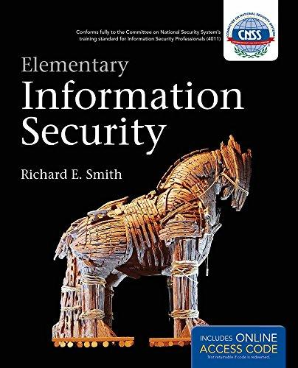
Course Book (Weeks 2 - 5)
ELEMENTARY INFORMATION SECURITY. Richard E. Smith. Jones & Bartlett Learning, 2011. ISBN 10: 1449648207 / ISBN 13: 9781449648206.
Available through Amazon or at RGU‘s library.

Slide 7
Today’s Plan
What is virtualisation?
Techniques to virtualise the x86 architecture
Other uses of virtualisation
Virtual Machines
Lab: Creating a virtual machine

Slide 8


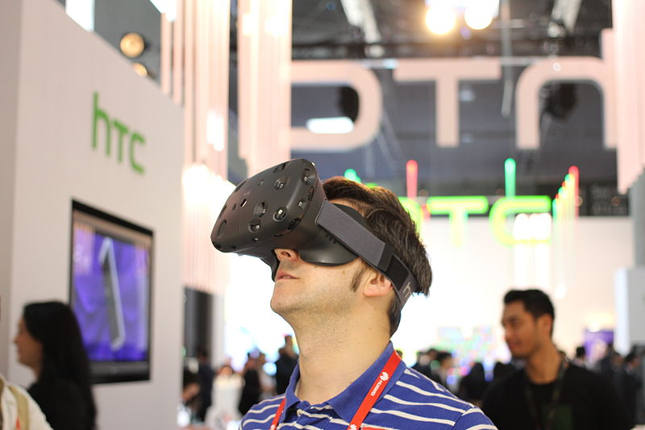


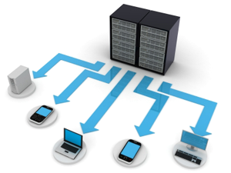
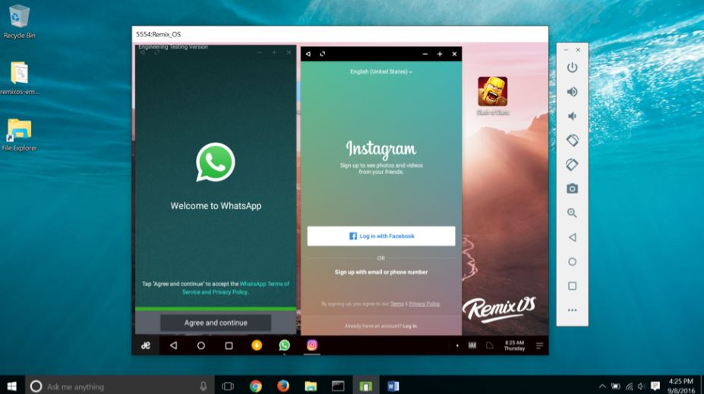
Virtualisation
Notes:
-Creating a virtual rather than an actual entity (wiki)
-Emulate
-Ability to have checkpoints/snapshots
-Create an alternative world?
-Simulate virtual machines

Slide 9
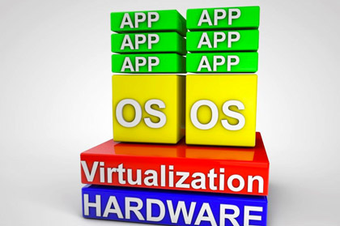
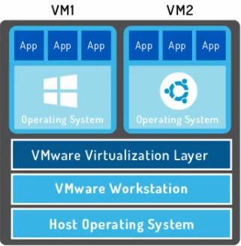
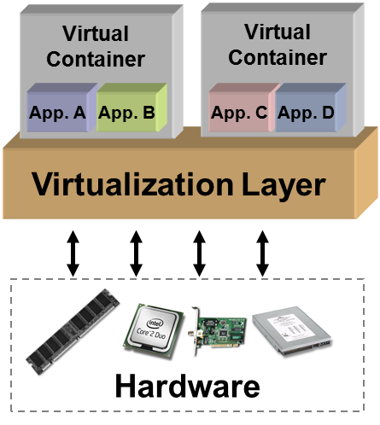
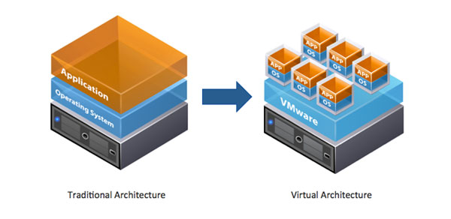
Adding a layer… but where?
“Creation of a virtualisation layer which maps interfaces onto the resources of a real system”.
Why Hypervisor?
“Implementation of a Virtual Machine Manager (VMM), also called Hypervisor”.
Notes:
-A VMM is also called hypervisor because this is a variant for the word supervisor, traditionally used for the kernel of an OS.
-Therefore the hypervisor supervises the supervisor!

Slide 10
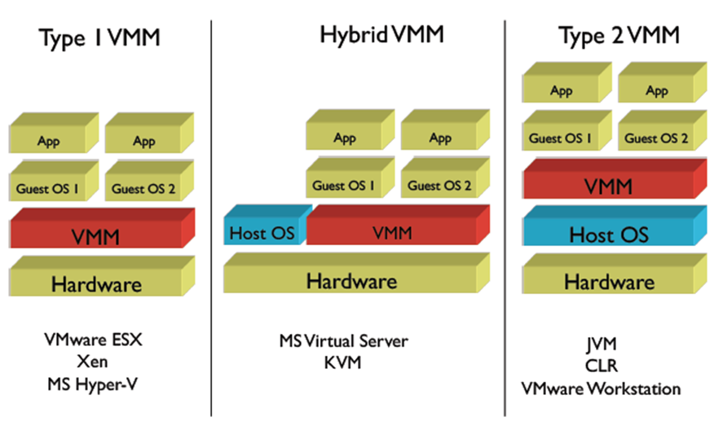
Types of Virtual Machine Managers/Hypervisors
CSE443 (Spring 2012). Introduction to Computer and Network Security. Professor Jaeger. www.cse.psu.edu/~tjaeger/cse443-s12/
Notes:
VMWare ESX: Elastic Sky X
Xen: Open Source hypervisor project.
KVM: Kernel-based Virtual Machine for Linux (hybrid because it converts the host OS into a type 1 VMM).
JVM: Java Virtual Machine
CLR: Common Language Runtime (.NET)

Slide 11
Benefits of virtualisation?
Abstraction
Abstraction
Replication
Isolation
Cross compatibility
Efficiency of resources
Recovery and Backup
Legacy SW usage
Testing
Save £££
Disadvantages?
More complexity
Single physical point of failure
Spend more £££
Notes:
-Save money on buying physical computers.
-Spend more money on software and licenses for the virtualised machines.

Slide 12
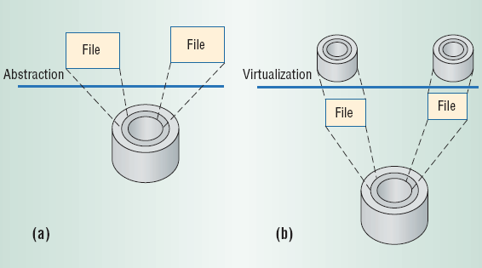
Abstraction vs Virtualisation
A classical computer architecture benefits from abstraction.
Well-defined interfaces for HW and SW to use.
Limits are based on the HW implementation.
In virtualisation, interfaces and resources may be mapped to different architectures.
Abstraction

Slide 13
Techniques to virtualise the x86 architecture

Slide 14
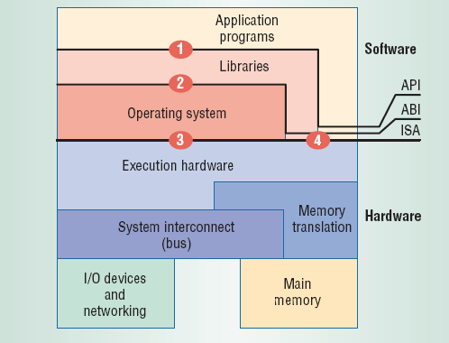
Where can virtualisation occur?
Three possible junctions:
API – Application Programming Interface
ABI – Application Binary Interface
ISA – Instruction Set Architecture
Notes:
-4 means between libraries and hardware OR application programs and hardware.

Slide 15
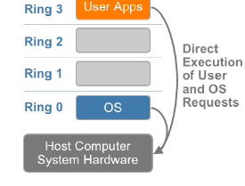
Requirements of x86 virtualisation
The OS needs direct access to memory and HW, thus it runs in Ring 0 (kernel).
The Rings 1 and 2 are usually for device drivers.
User level applications run in Ring 3.
Virtualisation of the x86 architecture required placing a virtualisation layer under the OS to create and manage the VMs.
VMware resolved the challenge in 1998, developing binary translation techniques, also known as full virtualisation.
Which type of virtualisation does this resemble the most?
Notes:
All of them and none!
-It is not type 1 because there is host OS.
-It is not type 2 because it goes under the OS, but VMWare Workstation is currently type 2.
-it most resembles hybrid, but the VMM has to go under the OS.

Slide 16
Full virtualisation

Slide 17
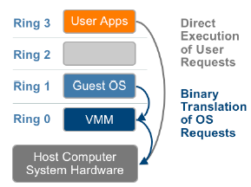
Full virtualisation using binary translation (VMWare)
The hypervisor occupies Ring 0 and translates kernel code into Ring 3 instructions, replacing nonvirtualisable code with new sequences of instructions that have effect on the virtual hardware.
The Guest OS is not aware that it is being virtualised, and thus requires no modification.
Which type of virtualisation does this resemble the most?
Notes:
-The OS now becomes a guest OS, so this is type 1.

Slide 18
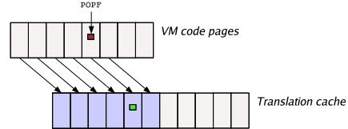
Full virtualisation using binary translation (VMWare)
Code running in each VM is scanned “on-the-fly” for nonvirtualisable instructions and is rewritten into a safer form.
Directly inline VMM functionality into the VM code – e.g., fast versions of I/O processing code.
Maintains a translation cache of recently-rewritten code pages, avoiding high overhead for rescanning and rewriting on each execution pass.
Notes:
-POPF (POP Flag): Instruction to clear/set the x86 architecture’s FLAGS register, which determines whether or not the CPU will handle maskable hardware interrupts.

Slide 19
Para-virtualisation/OS assisted virtualisation

Slide 20
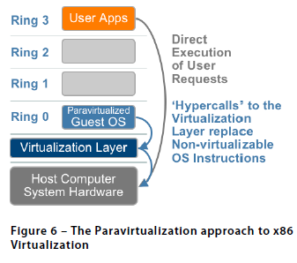
Para-virtualisation/OS assisted virtualisation
Modifying the OS kernel to replace nonvirtualisable instructions with hyper calls that communicate directly with the virtualisation layer.
Para-virtualisation is different from full virtualisation, since OS knows it is being virtualized and sensitive OS calls are not trapped using binary translation.
The performance advantage of para-virtualisation over full virtualisation can vary greatly depending on the workload.

Slide 21
Para-virtualisation/OS assisted virtualisation
Para-virtualisation cannot support unmodified OS (e.g. Windows 2000/XP).
Examples: XEN virtualises the processor and memory using a modified Linux kernel and virtualizes the I/O using custom guest OS device drivers.
Advantage: Easier to modify the host than to implement full virtualisation.

Slide 22
Hardware assisted virtualisation

Slide 23
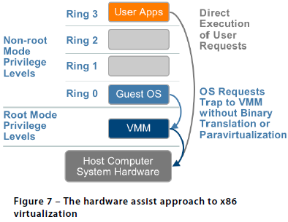
Hardware assisted virtualisation
In the mid 2000’s, AMD and Intel made processors that support VMs (AMD-V and Intel VT-X), allowing a new CPU execution mode feature that allows the VMM to run in a new root mode below Ring 0.
Privileged and sensitive calls are set to automatically “trap” to the hypervisor, removing the need for either binary translation or paravirtualisation.

Slide 24
Relation between types of VMM and Techniques for x86 virtualisation
The relation between both categorisations is quite strange!
Full virtualisation seems Type 1 VMM, but in practice is simulated.
An example of para-virtualisation is XEN, which is formally categorised as Type 1 VMM but in theory should be Type Hybrid.
Hardware assisted techniques seem Type 1 VMM, but in practice VMWare Workstation is Type 2 VMM.
Moreover, some literature mentions “OS assisted virtualisation” (i.e. FreeBSD) which resembles Type Hybrid.

Slide 25
Other uses of virtualisation

Slide 26
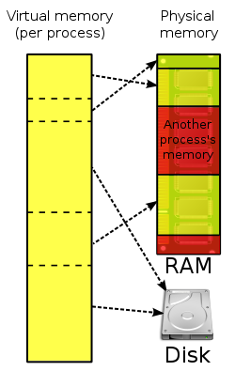
Memory virtualisation
The OS keeps mappings of virtual page numbers to physical page numbers stored in page tables.
The guest OS continues to control the mapping of virtual addresses to the guest memory physical addresses, but the guest OS cannot have direct access to the actual machine memory.
The hypervisor becomes responsible for mapping guest physical memory to the actual machine memory.
Memory virtualisation in a single computer is called virtual memory.
All modern x86 CPUs include a memory management unit (MMU) and a translation look-aside buffer (TLB) to translate virtual and physical memory access.
https://en.wikipedia.org/wiki/Virtual_memory
Notes:
-Virtual memory is the one used by a VM or the one used sometimes by OS such as Windows to allocate memory to certain processes.

Slide 27
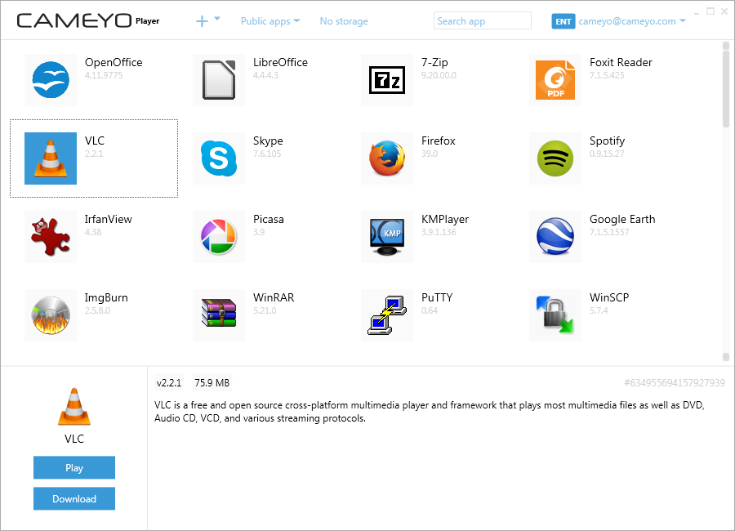
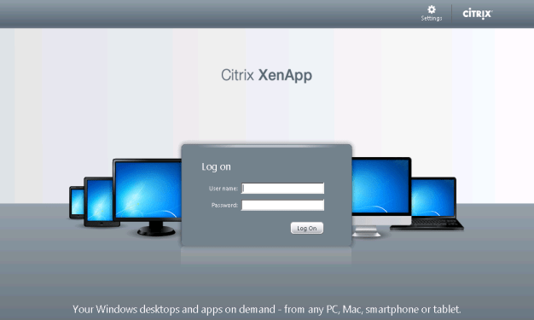
Application virtualisation
Encapsulate a computer program from the OS in which it is executed.
Sandbox for legacy applications.
Allows applications to run in non-native OS in a “portable” way.
The VM is created when the process is initiated, and is destroyed when the application is exited.
Examples: Cameyo, Ceedo, Citrix XenApp.
https://www.cameyo.com/cameyo-offline/
http://bretty.me.uk/citrix-slow-web-interface-5-4/
Notes:
-Citrix is the one used in the computer to run RGU MyApps.

Slide 28
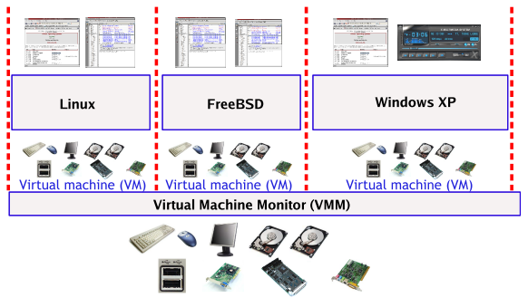
Virtual Machines
OS is abstract to the physical hardware. Each VM has its own…
“virtual CPU” (Thread)
“virtual memory” (Process and Address Space)
“virtual disk” (Filesystems)
Programs in the VM have to use system calls to request services from the OS.
Two types:
Process Virtual Machines (application virtualisation).
System Virtual Machines (VM created by VMWare).
M. Sudha, G. Harish, A. Nandan, and J. Usha, “Performance Analysis of Kernel-Based Virtual Machine,” International Journal of Computer Science & Information Technology (IJCSIT), vol. 5, no. 1, pp. 137–144, 2013.

Slide 29
Lab 1: Creating a Linux Virtual Machine using VMware

